Slide 1


SAP UI5 FIORI
JavaScript - Part B
www.zarantech.com
© Copyright 2021, ZaranTech LLC. All rights reserved.

Slide 2

Disclaimer
2
This presentation, including examples, images, and references are provided for informational purposes only.
Complying with all applicable copyrights laws is the responsibility of the user.
Without limiting the rights under copyright, no part of this document may be reproduced, stored or introduced into a retrieval system, or transmitted in any form or by any means.
Credits shall be given to the images taken from the open-source and cannot be used for promotional activities.

Slide 3
Agenda
3
Variable Scope
Arrays
if, else, nesting if, complex conditions, switch
While loop and For loop
Objects, Properties, and methods
Referencing elements in JavaScript
Changing an Image Source
Forms and Form Values
Forms validation text boxes and passwords

Slide 4
Variable Scope
2
Scope refers to the visibility of variables. In other words, which parts of your program can see or use it.
Normally, every variable has a global scope. Once defined, every part of your program can access a variable.
Types of variable scopes:
Local variable.
Global variable.
‹#›

Slide 5
Arrays
2
An array is a special variable, which can hold more than one value at a time.
An array can hold many values under a single name.
We can access the values by referring to an index number.
To create a JavaScript Array, using an array literal is the easiest way.
There are array methods, array sorting, array iterations, and so on in JavaScript.
Array syntax –
var stringArray = ["one", "two", "three"];
‹#›

Slide 6
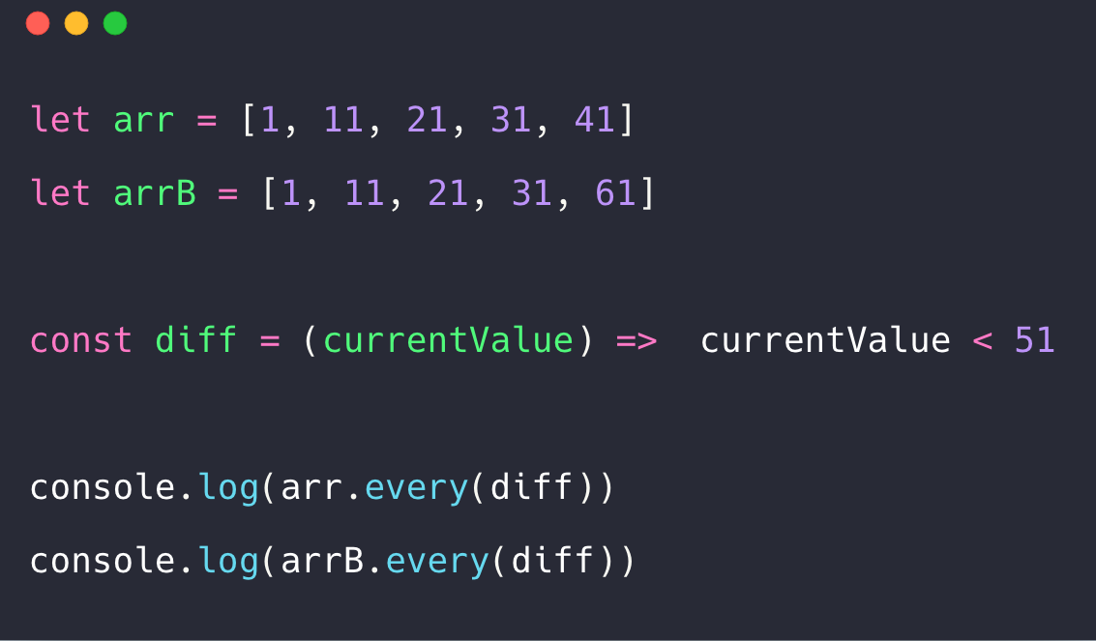
Arrays
2
‹#›

Slide 7
if, else, nesting if, complex conditions, switch
2
In JavaScript we have the following conditional statements and each of them are represented by
respective syntax:
Use if to specify a block of code to be executed, if a specified condition is true.
Use else to specify a block of code to be executed, if the same condition is false.
Use else if to specify a new condition to test, if the first condition is false.
Use nesting if to specify an if statement inside another if statement.
Use switch to specify many alternative blocks of code to be executed.
‹#›

Slide 8
While loop and For loop
2
In JavaScript we have the following loops and each of them are represented by respective syntax:
for - loops through a block of code a number of times.
for/in - loops through the properties of an object.
for/of - loops through the values of an iterable object.
while - loops through a block of code while a specified condition is true.
do/while - also loops through a block of code while a specified condition is true.
‹#›

Slide 9
Objects, Properties, and methods
2
Objects - A javaScript object is an object-based language and an entity having state and behavior
(properties and method) and object-based language.
Properties - Properties are the values associated with a JavaScript object. Though some properties are read only, but it can be changed, added, and deleted as well.
Methods - JavaScript method is a property containing a function definition and are actions that can be performed on objects.
‹#›

Slide 10
Referencing elements in JavaScript
2
There are several ways to find element:
Finding HTML elements by id
Finding HTML elements by tag name
Finding HTML elements by class name
Finding HTML elements by CSS selectors
Finding HTML elements by HTML object collections
Syntax - getElementById("element"). style. display = "none";
‹#›

Slide 11
Changing an Image Source
2
The src property can be changed at any time.
The src property sets or returns the value of the src attribute of an image.
The required src attribute specifies the URL of an image.
Syntax -
Return the src property: imageObject.src
Set the src property: imageObject.src = URL
‹#›

Slide 12
Forms and Form Values
2
HTML form validation can be done by JavaScript.
If a form field (fname) is empty, this function alerts a message, and returns false, to prevent the
form from being submitted.
Typical form control objects also called "widgets" include the following:
Text box for entering a line of text
Push button for selecting an action
Radio buttons for making one selection among a group of options
Check boxes for selecting or deselecting a single, independent option
‹#›

Slide 13
Forms validation text boxes and passwords
2
Form validation generally performs two functions:
Basic Validation Data
Format Validation
To create a Forms validation text boxes and passwords follow this basic steps,
Add HTML
Add CSS
Add JavaScript
‹#›

Slide 14
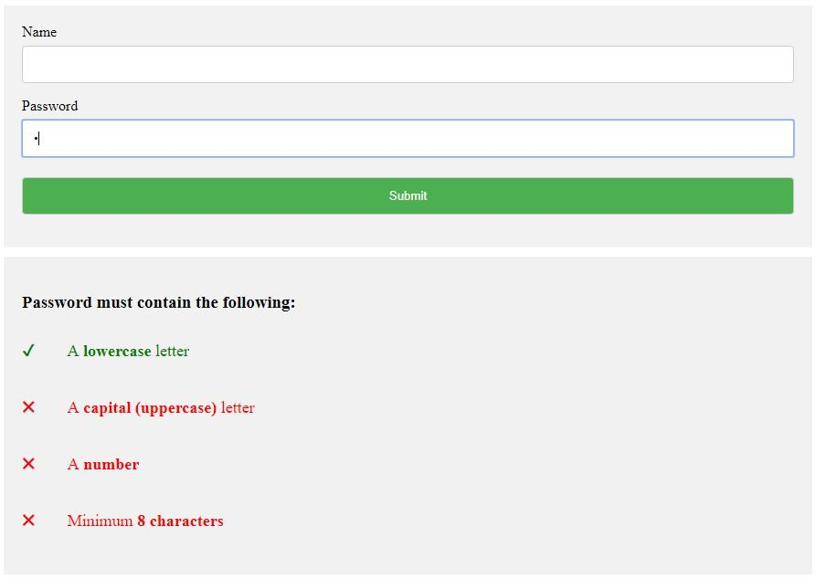
Forms validation text boxes and passwords
2
Screenshot of an Form Validation text boxes and passwords
‹#›

Slide 15
Thank you
Please leave your feedback after the session
www.zarantech.com

